Slide 1
ECG Classification

Slide 2
Background
- Heartbeat shape and peaks
- Arrhythmia classification
- Example waveforms

Slide 3
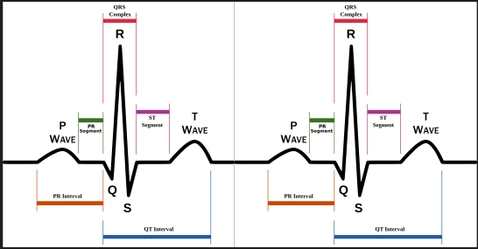
Heartbeat shape

Slide 4
Arrhythmia classification
Classes:
N : Normal beats
S : Supraventricular ectopic beats
V : Ventricular ectopic beats
F : Fusion Beats
Q : Unknown Beats

Slide 5
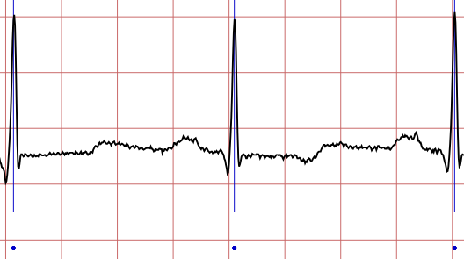
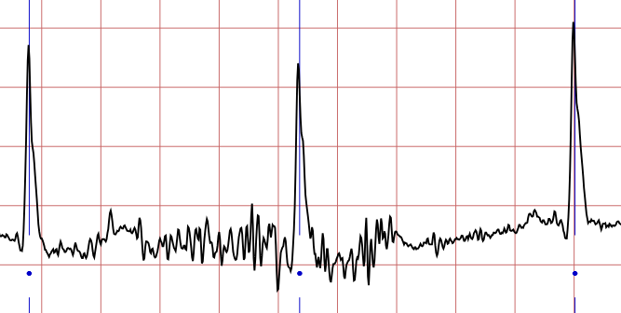
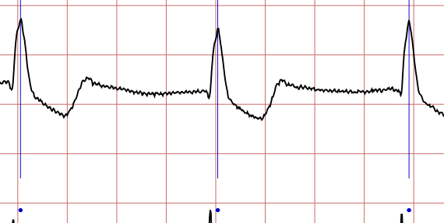
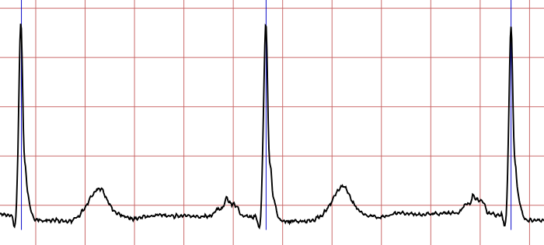
Normal Beats

Slide 6
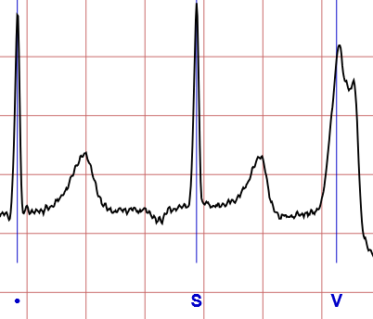
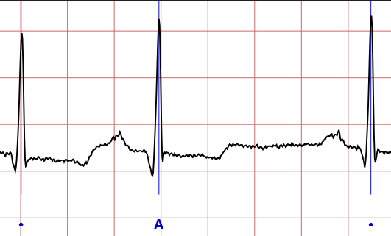
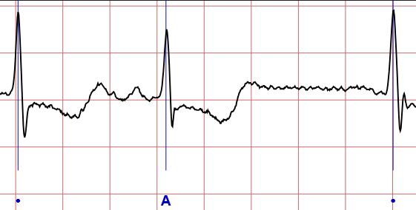
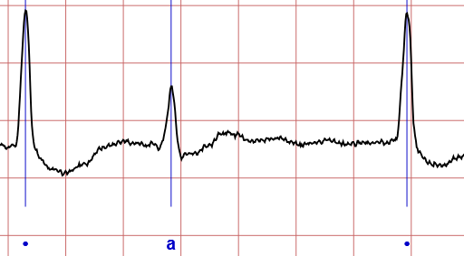
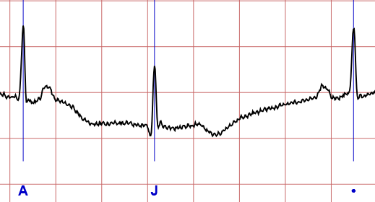
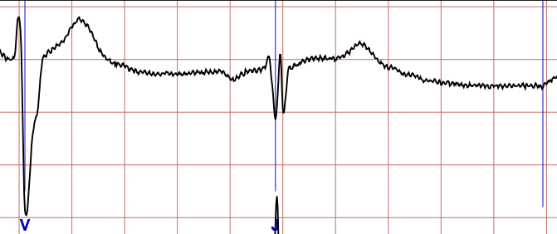
Supraventricular Premature Beats

Slide 7
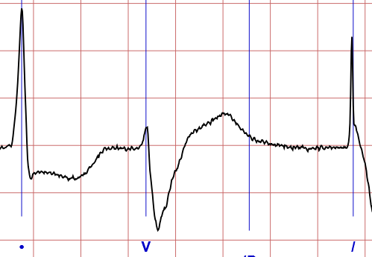
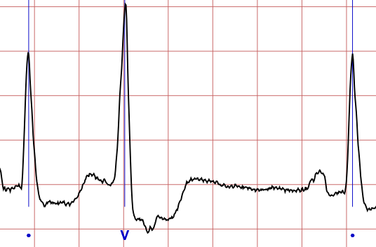
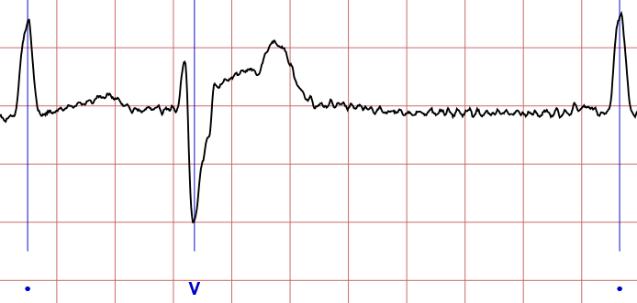
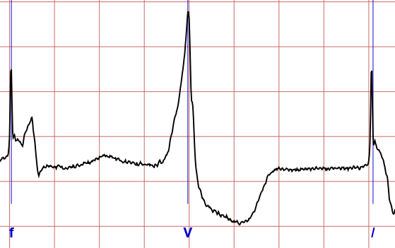
Premature Ventricular Contraction

Slide 8
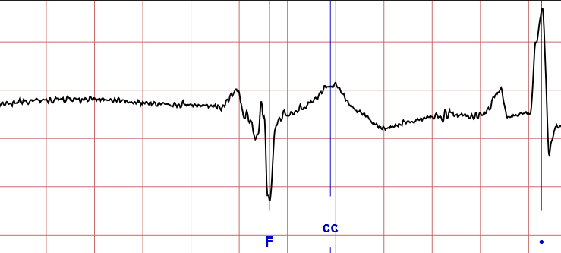
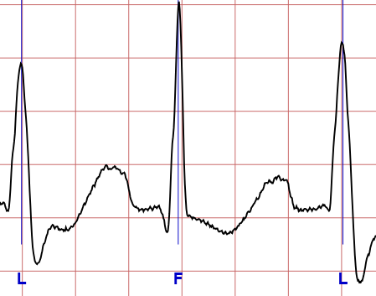
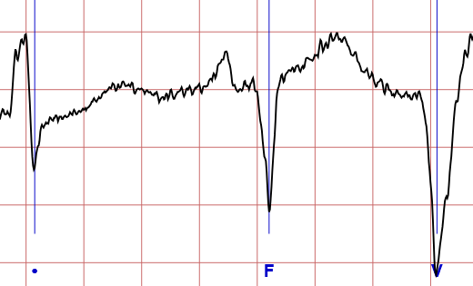
Fusion Beats

Slide 9
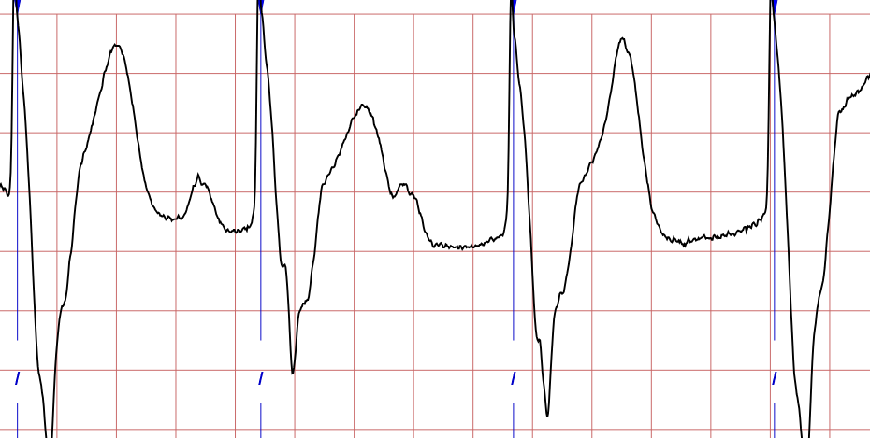
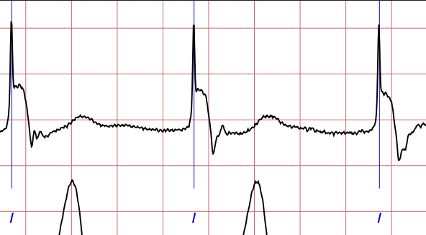
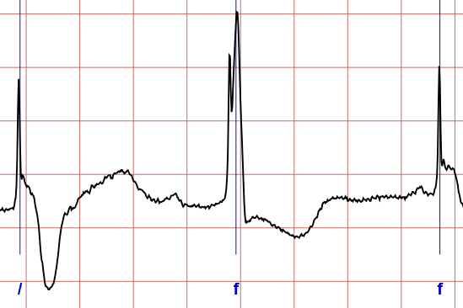
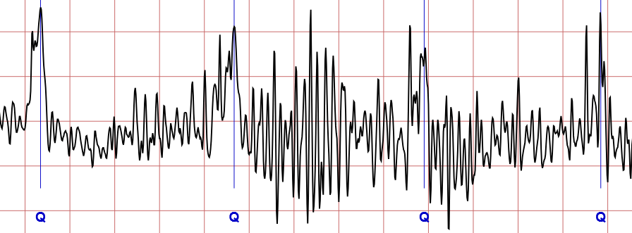
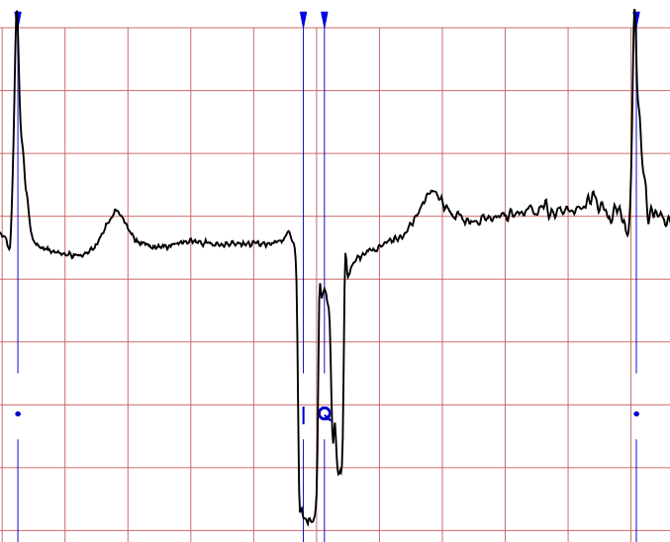
Unclassifiable Beats

Slide 10
Classification work
Normalized dataset:
CNN + MLP
Picchi/valli + MLP
Original waveforms dataset:
Picchi/Valli + MLP
Major Peaks + MLP
Other tests:
KNN classifier

Slide 11
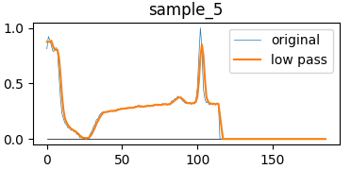
Normalized dataset
Fixed length of 187 points
Zero padding for shorter heartbeats
Normalized amplitude 0-1
Each heartbeat starts from the classification peak of the previous heartbeat

Slide 12
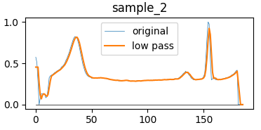
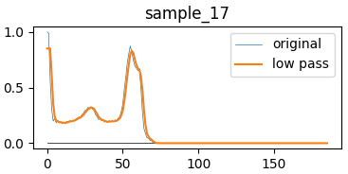
Classic CNN+MLP
Convolution for feature extraction
MLP for classification

Slide 13
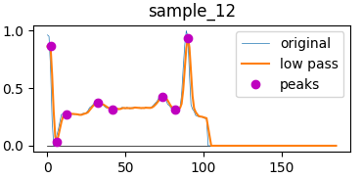
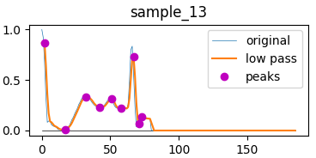
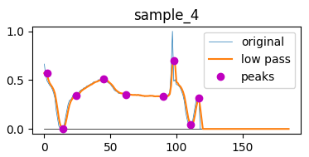
Picchi/Valli + MLP
Select important points based on:
Local max or min
Amplitude difference from previous point
Time difference from previous point

Slide 14
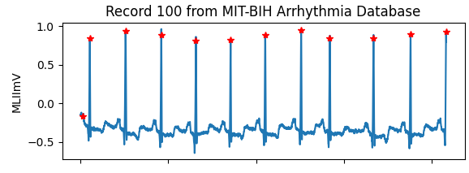
Original waveforms dataset
Raw readings from the ECG machine
Each beat is classified by doctors on the R peak

Slide 15
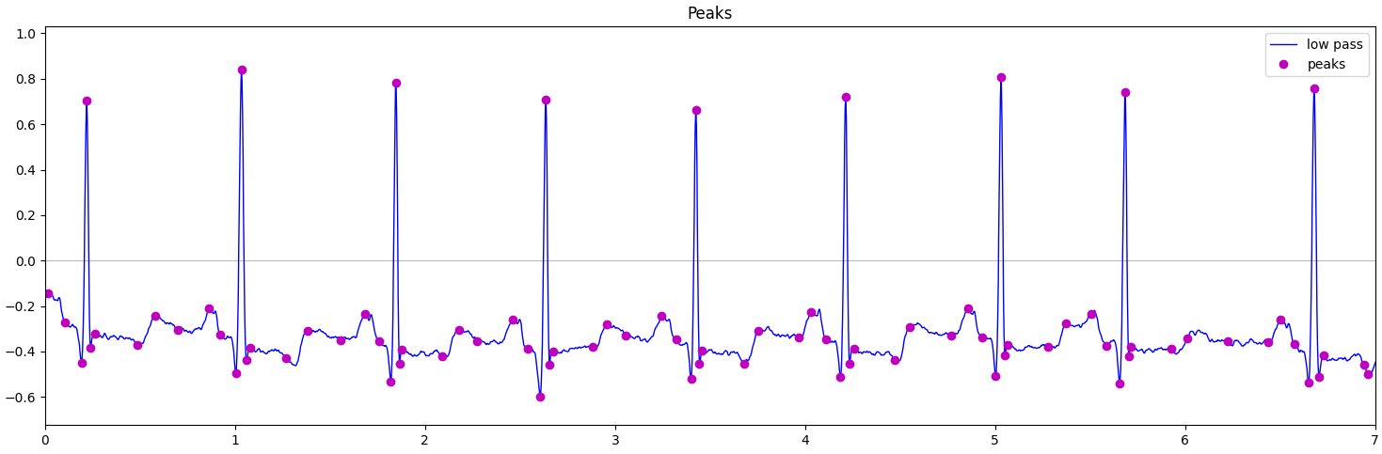
Picchi/Valli + MLP
Same as before but applied to original signal

Slide 16
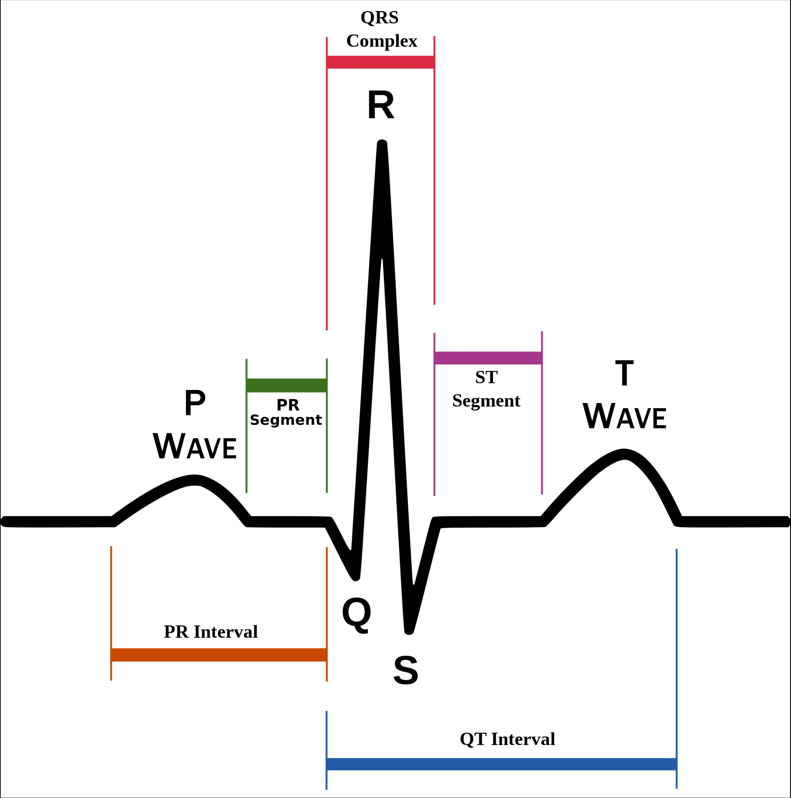
Major Peaks + MLP
Extract the P,Q,R,S,T wave peaks instead of random peaks and valleys
Why:
These points are used as reference by doctors when reading ECGs
They’re directly connected to the electrical activity of the heart
How:
R peak : Pan-Tompkins algorithm (now we look at the annotation)
Q/S peaks : local minimum close to R peak
P/T peaks: phasor transform

Slide 17
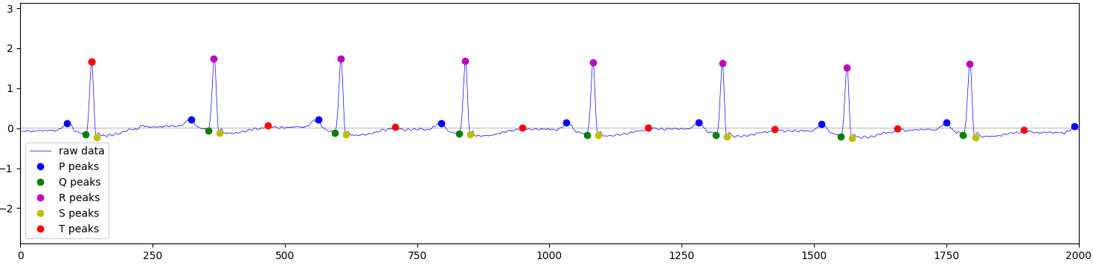
Major Peaks + MLP
We can try multiple combinations of points as features
We can extract other useful data:
Average BPM
Heartbeat variability

Slide 18
Other
Comparison between CNN+MLP and CNN+KNN
Classic training CNN+MLP
Select last conv layer output as input for the KNN
N model | Features | CNN+MLP | CNN+KNN
Ref. | 33 | 0.880
10 | 62 | 0.885 | 0.912
11 | 13 | 0.788 | 0.867
12 | 37 | 0.877 | 0.867
13 | 37 | 0.856 | 0.867
14 | 12 | 0.791 | 0.867
15 | 124 | 0.883 | 0.943
17 | 30 | 0.887 | 0.915
18 | 30 | 0.888 | 0.917
19 | 10 | 0.786 | 0.846
20 | 20 | 0.851 | 0.896

Slide 19
Current results

